Slide 1
End-to-End Encrypted Git Services
Ya-Nan Li | Yaqing Song | Qiang Tang | Moti Yung
The University of Sydney | UESTC | The University of Sydney | Google & Columbia University
Sydney, Australia | Chengdu, China | Sydney, Australia | New York, United States
CCS 2025

Slide 2
1. Git service
Introducing the Git service and privacy concerns
2. Git cannot offer E2E secure
Security, Overhead and Platform Compatibility
3. Results & Contributions
Formalizing critical security properties: Confidentiality & Repository unforgeability; Balancing overhead &security
4. Construction &Experimentation
2 constructions: SGitLine & SGitChar; Conducting experiments on 6 public repos,

Slide 3
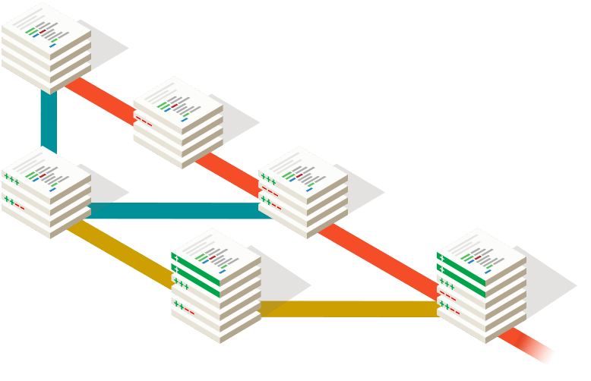



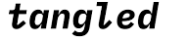



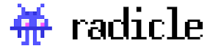

What is Git?
1.1
Git: Distributed Version Control System​
Tracks file change records​ and version rollback​ as repository, provides branch management capabilities
Supports multi-person collaborative development​ and synchronize to Git
` Git is indispensable in the IT industry `
Notes:
Git :Open-source, enabling efficient management of code and file versions, 分布式版本控制系统，支持项目管理和多元合作，通过上述平台。
平台中包含完整的项目数据，不光是文件，还有存储结构等，构建成一个仓库。
然后git的仓库中还包含了每一个更新的版本以及相应的存储结构；
Git仓库可以分为公开和私有两种模式。
2025: GitHub’s user base grew to over 150M developers, with 420M+ repositories.

Slide 4

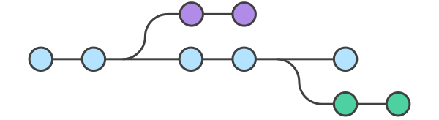





1.2
The rising demand for e2E security
Why Existing Git Platforms’ Security Mechanisms Are No Longer Sufficient？
1. Data is visible to the server.
2. Access control relies on the server.
Data in private repositories is also visible to server
author A
Git server
Unauthorized modifications in collaboration can affect the final product.
Plain file
master
Partially solution:
optional verified commit signature, features relies on servers
author B
Client
Client need privacy
` E2E encryption is needed to ensure `
Notes:
无论对个人还是企业，隐私都很重要，
1因为现行git上的仓库即使是私人的，服务器也可见。那么即使服务器可信，也有服务器被外部或者内部攻破的风险
2git上的合作事实上形成了一种软件供应链，那么每一步的编辑都影响了最终产品的形成，所以每一次未经认证的编辑行为都很危险。需要每次编辑的完整性，完备的访问权限控制和真实性。处理编辑者身份需要可验证的提交签名，但是现有方案的commit sign依赖服务器认证，所以如果服务器恶意，访问控制也就无从下手。

Slide 5
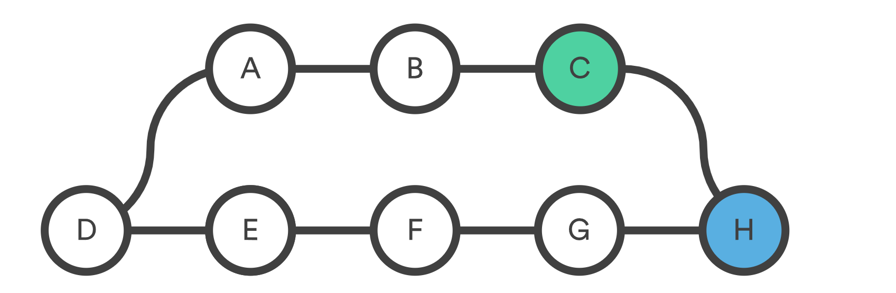


2.1
E2E secure Git service is not yet available.
E2E Encrypted Cloud Storage Can not Replace E2E Git Security Directly
C
Functional Mismatch​​
Security Inadequacy​
Efficiency Issues​
H
master
pull
push
1. push/pull require cloud to compute the mini missing parts | no Branch merging
2. Data is updating ​each time, greater need for access control | Static data
3. Save full edit chain lead to strong computation, communication and storage costs; | Only final version
Git server
Cloud storage
` Git’s unique workflow (dynamic updates, collaborative editing) requires a special design `
Notes:
1. Functional Mismatch​
Git core operations (push/pull): Require server-side computation​.
Git "pull": Needs server to compute & return minimal missing parts (client can’t identify)​
Cloud storage: No computation, only pre-specified content return​
2. Security Inadequacy​--更新
Git requires:​ Protection for dynamically updated data​ ;
"Unforgeability" for access control (e.g., read-only users can’t write)​
Cloud storage: Only protects static data (basic confidentiality/integrity)​
3. Efficiency Issues​
Git: Needs full edit chain for history tracking​.
Requires cross-version data deduplication (cost minimization)​
Cloud storage: usually retains only one version

Slide 6





2.2
E2E secure Git service is not yet available.
E2E Encrypted Cloud Storage Can not Replace E2E Git Security Directly
Security risks in existing ad hoc secure Git service designs
On an untrusted server：
1. Not Confidentiality
2. Failed Integrity
3. Lack of Unforgeability
Git-crypt & Gringotts: deterministic encryption, weak protection, vulnerable to injection attacks
protected
deletion
2. git-secret & Keybase: users choose which file to protect. Entire repository lacks protection.
Mal injection leading to errors(data key) being used later by collaborators .
author A read&write
illegal push
Unforgeability: read-write access separation.
No party can assume the rights of any user.
master
author B read-only
` Need to design a formal analyzed E2E encrypted Git service. `
Notes:
确定性加密 “不行” 的核心矛盾
它在 “效率”（密文压缩、减少存储）和 “安全性”（机密性、抗泄露）之间采取了极端倾斜 —— 为了降低存储成本，完全牺牲了 E2E 加密所需的 “明文不可推断” 核心属性，既无法抵御针对数据模式的分析攻击，也无法适配 Git 版本控制中 “增量更新、重复数据多” 的特性，最终导致其无法满足 Git 服务（尤其是敏感项目协作）对 “强机密性” 的需求。这也是文档中提出的 SGitChar、SGitLine 方案放弃确定性加密，转而采用 “细粒度加密 + 增量密文” 设计的关键原因。
攻击者借助加密方案的设计缺陷，“偷偷” 往加密的仓库 / 文件中塞恶意内容，而用户解密后会不知不觉中招
攻击者可通过分析重复密文片段，识别明文数据的模式（如代码中的固定语法、配置文件结构）；
进一步注入与合法密文片段格式一致的恶意密文，当用户解密时，恶意内容会被还原并混入正常数据（如在代码仓库中注入恶意脚本、篡改配置参数）；
由于这类方案缺乏完整性校验，用户无法察觉密文已被注入篡改，导致攻击成功。

Slide 7
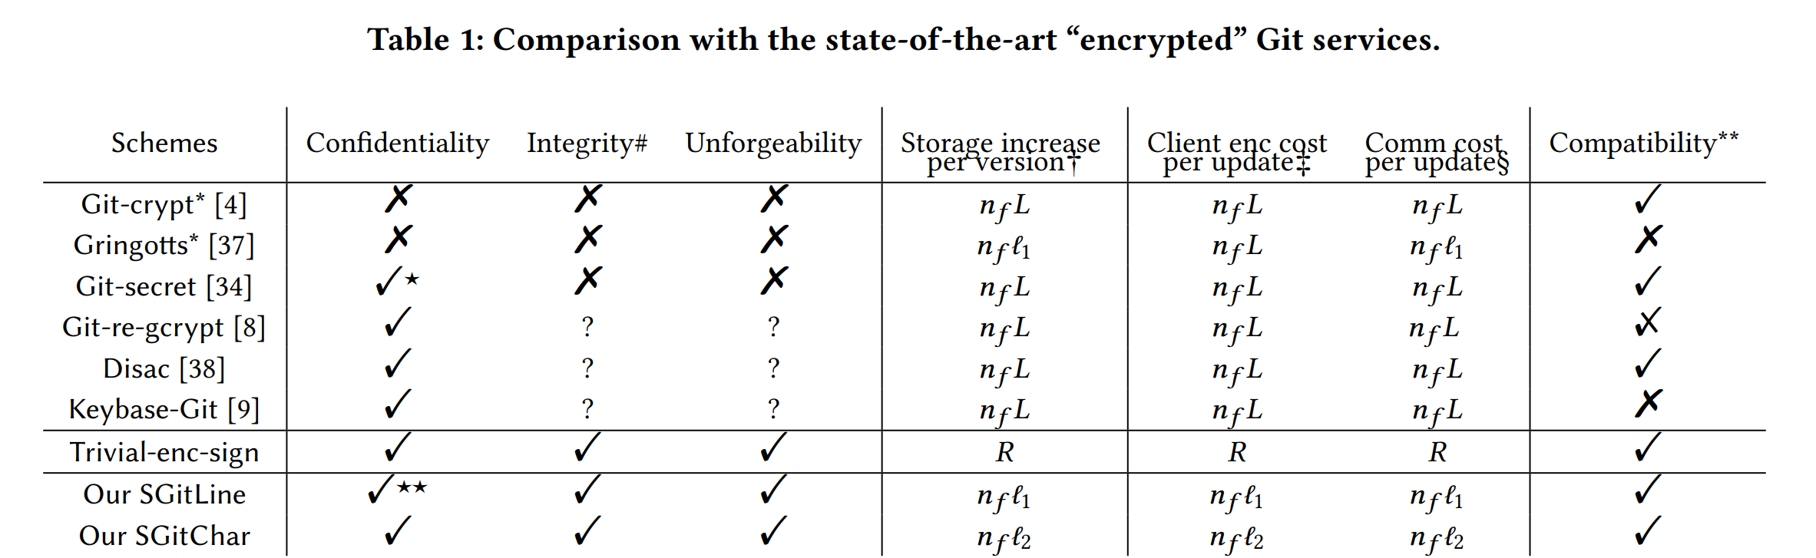



2.3
E2E secure Git service is not yet available.
E2E Encrypted Cloud Storage Can not Replace E2E Git Security Directly
Security risks in existing ad hoc secure Git service designs
Overhead Challenges in Existing Solutions
File-wise, line-wise or char-wise
File-wise
Line-wise
Char-wise
n_f 表示每个存储库版本中更改文件的数量。
L, R：分别表示文件和存储库的（平均）大小。
L1,L2 ：表示每次文件更新时，平均每行更改和每个字符更改的大小。
` Goal: Overhead proportional only to actual edits. `
Notes:
"Trivial-enc-sign": Re-encrypts the entire repository for every edit (even 1 character change).
File-wise tools (Git-crypt, Git-secret): Overhead proportional to file size, not actual edits.
根本原因在于，它们处理的是整个文件/存储库，而非跟踪细微的变化。没有利用 Git 的基于差异的更新机制来进行加密操作。
Line-wise : gringotts, 但是会暴露更新位置等，而且是确定性加密，隐患很大。可以轻易的知道短短一行信息下更新了什么。
基于行级确定性加密（固定 AES 的 IV），支持跨文件压缩。
Git-re-gcrypt: 仓库级别的加密，上传每个完整的新版本。
可见主流加密都是文件级别的。我们直观上，希望用户端计算的，用户与远程仓库传输的，仓库设计增长的信息量，都和实际上有效的变化数据相关。

Slide 8
2.4
E2E secure Git service is not yet available.
E2E Encrypted Cloud Storage Can not Replace E2E Git Security Directly
Security risks in existing ad hoc secure Git service designs
Overhead Challenges in Existing Solutions
Platform Compatibility: Working with Existing infrastructure
Employ E2E encrypted services by simply installing a new secure Git client
` Use current Git-provided service operations `
Notes:
兼容性：与现有基础设施平台兼容，即用户直接下载一个新的安全的git客户端，无需git做出任何改动

Slide 9
3
E2E secure Git service ‘challenge
Identify and formalize critical security properties of an E2E encrypted Git service
Give provably secure constructions that are both with minimal overhead and platform-compatible with existing Git servers.
Notes:
critical security properties : 机密性，完整性，不可伪造性

Slide 10
3.1
result
` Identify and formalize critical security properties of an E2E encrypted Git service `
Give provably secure constructions that are both with minimal overhead and platform-compatible with existing Git servers.
Users trust cryptographic methods
Through cryptographic means, an ideal access control similar to a trusted server, achieving:
Confidentiality: Party without the permission to access confidential data cannot obtain content and update details;
Repository unforgeability: Party without write permission cannot forge or impersonate the identity of a legitimate user to write data.
Untrust server
Reliable cryptography
Client
Update details :Operation type (insert/delete),
Modification position (line number, character position),
Modification length
Notes:
GIT元数据
更新元数据：SGitChar保护 操作类型（插入 / 删除）、修改位置（如行号、字符位置）、修改长度、版本更新频率；
结构元数据：文件名、目录结构、文件数量、文件大小等；git平台需要通过文件名和路径追踪文件
行为元数据：用户访问时间、协作关系（谁与谁共享）、编辑频率等。共享需通过服务器传递共享请求

Slide 11
3.2
result
Identify and formalize critical security properties of an E2E encrypted Git service
` Give provably secure constructions that are both with minimal overhead and platform-compatible with existing Git servers. `
Dilemma (Overhead vs. Security):
- Encrypting entire files before pushing disables Git's diff calculation, increasing overhead.
- Line-by-line encryption exposes specific update positions.
2. Need: - Leverage Git's diff functionality
- No changes to Git platform's overall design
Notes:
critical security properties : 机密性，完整性，不可伪造性

Slide 12
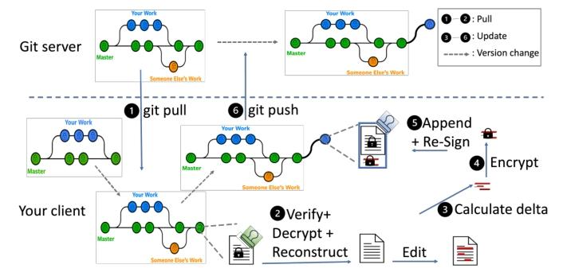
3.3
Contributions
Presenting formal syntax and security models for E2E encrypted Git service, data confidentiality and repository unforgeability.
2 constructions: SGitLine (line-wise) and SGitChar (char-level, update details-hiding), both compatible with existing Git platforms.
Implementation. Conducting experiments on 6 GitHub repos, and showing overhead advantages.
The main workflow of SGit

Slide 13

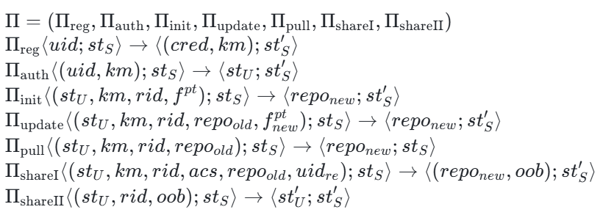






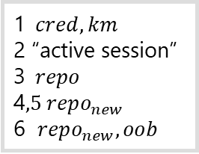


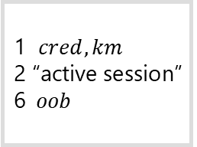







4.1
Syntax & Security models
1. $uid$
Remote repo
2. $cred$
$$st_{S}$$
Git server
3. $rid,f^{pt},km$
4. $rid,f_{new}^{pt},repo_{old},km$
Security
setup: PKI, OOB.
Data confidentiality
Repository unforgeability
5. $rid,repo_{old},km$
$$st_{U}$$
6. $rid,repo_{old},km,acs,uid_{re}$
6. $rid,oob$
$$st_{U}$$
Client
$$6.oob$$
ClientB
1$cred,km$
2 “active session”
3$repo$
4$,5 repo_{new}$
6 $repo_{new}, oob$
1 $cred,km$
2 “active session”
6$oob$

Slide 14
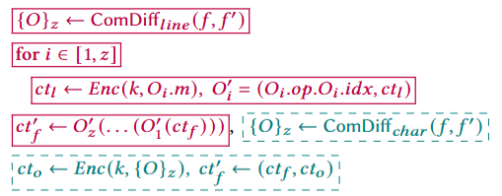
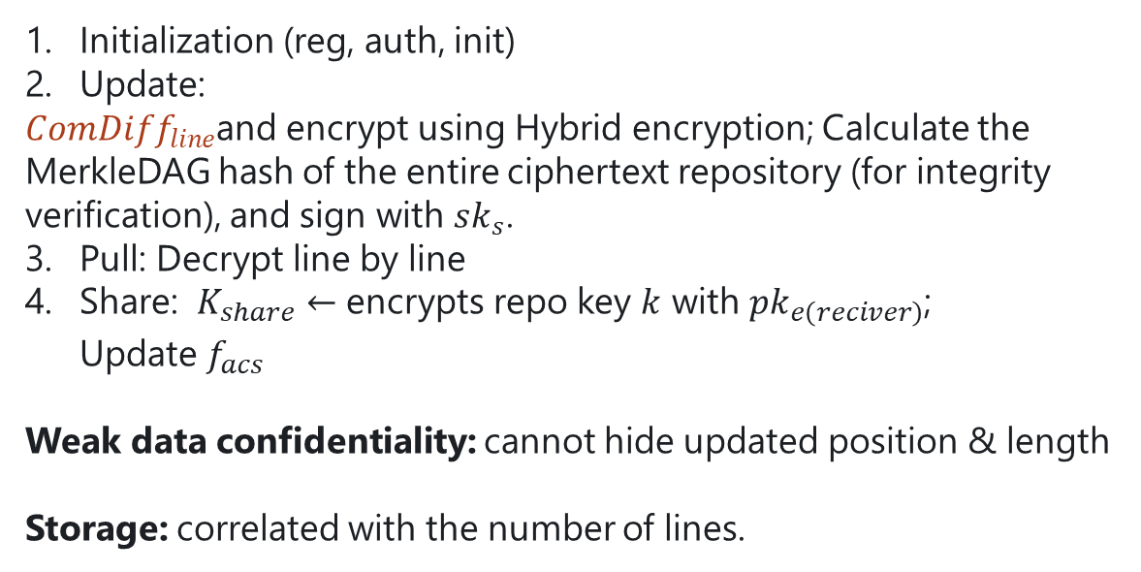
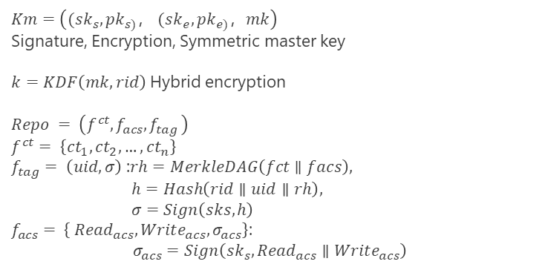
SGitLine
4.2
Initialization (reg, auth, init)
Update:
$ComDiff_{line}$and encrypt using Hybrid encryption; Calculate the MerkleDAG hash of the entire ciphertext repository (for integrity verification), and sign with $sk_{s}$.
Pull: Decrypt line by line
Share: $K_{share}←$ encrypts repo key $k$ with$pk_{e\left(reciver\right)}$; Update$f_{acs}$
Weak data confidentiality: cannot hide updated position & length
Storage: correlated with the number of lines.
$$Km=\left((sk_{s}, pk_{s)}， (sk_{e}, pk_{e)}，mk\right)$$
Signature, Encryption, Symmetric master key
$k=KDF\left(mk,rid\right)$Hybrid encryption
$$Repo = \left(f^{ct},f_{acs}{,f}_{tag}\right)$$
$$f^{ct}= \left\{ct_{1}, ct_{2}, …, ct_{n}\right\}$$
$f_{tag}= \left(uid, σ\right)$ :$rh=MerkleDAG\left(fct∥facs​\right),$
$h=Hash\left(rid∥uid∥rh\right),$
$σ=Sign\left(sks​,h\right)$
$f_{acs}= \left\{ Read_{acs}, Write_{acs},σ_{acs}\right\}$:
$$σ_{acs​}=Sign\left(sk_{s​},Read_{acs}∥Write_{acs}\right)$$

Slide 15
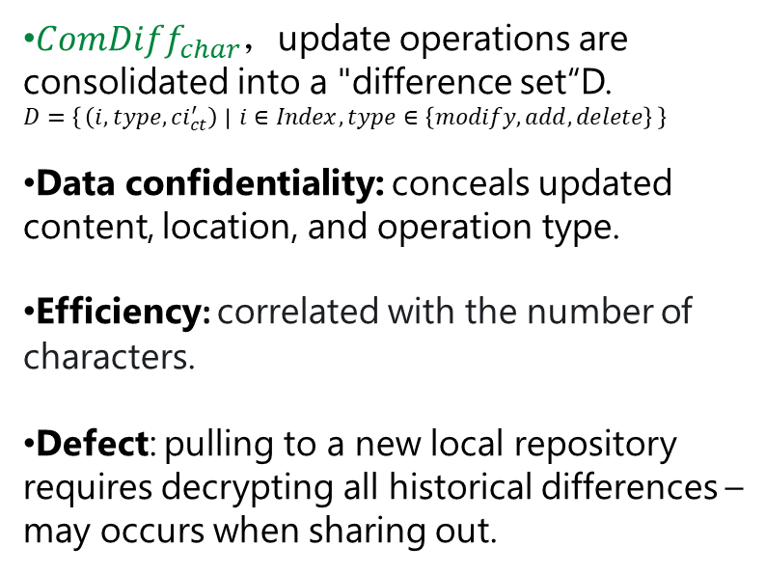
SGitchar
4.3
$ComDiff_{char}$，update operations are consolidated into a "difference set“D.
$$D=\left\{\left(i,type,ci_{ct}^{′​}\right) ∣ i∈Index,type∈\left\{modify,add,delete\right\}\right\}$$
Data confidentiality: conceals updated content, location, and operation type.
Efficiency: correlated with the number of characters.
Defect: pulling to a new local repository requires decrypting all historical differences – may occurs when sharing out.

Slide 16
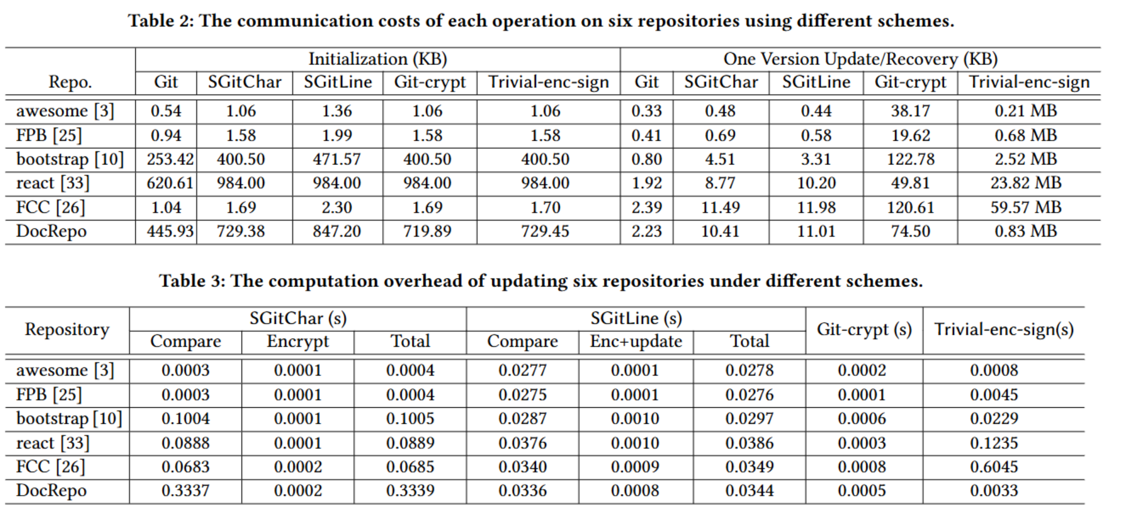
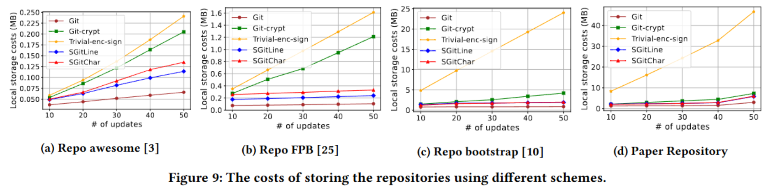
Implementation & Comparison of Overhead
4.4
Initialize | communication(KB)
update / pull | communication(KB)
update / pull | computation- diff (s)
 | computation- encrypt (s)
 | computation- all (s)
Pull(recover） | computation(s)
Multi-version store | storage (MB)
Python, pycryptodome library,
AES-CTR as enc
ECDSA as sign
SHA-256 as hash
HKDF-SHA-256 as key derivation

Slide 17
Implementation & Comparison of Overhead
4.5
SGitChar： Excellent Initialize / pull performance, low update communication cost, overall balanced;
SGitLine：Update communication cost is better than SGitChar, but update / pull calculation time is higher;
Git-crypt：Update calculation time is the lowest, but update communication cost is extremely high;
Trivial-enc-sign：The various costs (especially communication) are the highest, and the performance is the worst.
awesome | Initialize communication(KB) | Update communication(KB) | Update time (s) | Pull time (s)
SGitChar | 1.06 | 0.48 | 0.0004 | 0.0001
SGitLine | 1.36 | 0.44 | 0.0278 | 0.0048
Git-crypt | 1.06 | 38.17 | 0.0002 | 0.0001
Trivial-enc-sign | 1.06 | 210.0 | 0.0008 | 0.0008

Slide 18
Conclusion
5
Conclusion: First formal, systematic study on E2E encrypted Git services; formalizes core security properties (confidentiality, unforgeability) , proposes SGitLine/SGitChar
Open Problems - Security: Extend models to adaptive corruption; strengthen metadata security (hide access/edit patterns)
Open Problems - Functionality: Support flexible crypto group management, key rotation, revocation, accountability; integrate with web-based Git interfaces
Future Directions: Explore post-compromise security, Key rotation, Group Management…

